Slide 1

DEPARTMENT OF
ELECTRONICS AND COMMUNICATION ENGINEERING
ELECTRONIC DESIGN WORKSHOP ( U20ECP612)
LAND QUALITY ANALYZER USING IoT
TEAM MEMBERS
SUPERVISED BY
Dr.R.KURINJIMALAR
Professor/ECE
Dharshan S (21UEC038)
Bharathraj K (21UEC027)
Balaji T (21UEC021)

Slide 2
CONTENTS
Objective
Introduction
Problem Statement
Literature Survey
Proposed System
Result and Discussion
Conclusion
Future work
Reference

Slide 3
OBJECTIVES
The proposed approach focused on improving the channel capacity with data rate.
Increase in Signal to Noise Ratio leads to decrease in data rate and increase in channel capacity using Trained Neural network with various detection methods involved Least Square, Minimum Mean Square Error, Maximum Likelihood, Deep Learning comparison output to achieve this outcome.
Land Quality Analyzer using IoT is a system that allows farmers to monitor and analyze the quality of their land in real-time. The system is composed of IoT sensors that are placed on the land to gather data on various parameters such as temperature, humidity, and water flow but we can also measure moisture content, soil nutrients, and pH levels.
This system provides farmers with valuable insights into the health of their land, enabling them to make informed decisions about crop selection, irrigation, and fertilization. By optimizing these factors, farmers can improve their yields, reduce costs, and increase profitability.

Slide 4
INTRODUCTION
Land Quality Analyzer using IoT is a cutting-edge technology that integrates the Internet of Things (IoT) and soil science to assess the quality of land. This system uses sensors to collect data on various parameters such as soil pH, moisture, temperature, and nutrient content. The data is then transmitted to a cloud-based platform for analysis, where it is processed using advanced algorithms to generate a detailed report on the quality of the land.
This technology has revolutionized the way farmers and landowners manage their land. It enables them to make informed decisions regarding crop selection, irrigation, fertilization, and other critical factors that affect crop yields and the overall health of the soil.

Slide 5
PROBLEM STATEMENT
Manual Sampling and Laboratory Analysis:
Soil samples are collected manually and sent to laboratories for testing. This process can take several days to weeks and requires significant labor and costs.
Laboratory tests are often specific to particular parameters, necessitating multiple tests for a complete analysis. Use of Specialized Equipment:
Existing equipment for in-situ analysis is often expensive, bulky, and complex, requiring technical expertise to operate and interpret results.
These tools may not provide a comprehensive analysis, often focusing on specific aspects such as soil pH or moisture content but not offering a holistic view of land quality.
Limited Accessibility and Usability:
Small-scale farmers, urban planners, and environmental agencies in resource-limited settings may lack access to reliable land quality analysis tools.
There is a need for a solution that is portable, easy to use, and affordable while providing accurate and comprehensive data on land quality.

Slide 6
LITERATURE SURVEY
S.NO | TITLE | Authors | Key Areas | OBSERVATION
1. | IOT Based Smart Agriculture And Soil Nutrient Detection System | Akshay Badhe, Sandeep Kharadkar, Rushikesh Ware,Patrik Kamble (2022) | Real time data collection and monitoring, Sustainability of the system | The objective of the is to enhance farming efficiency, productivity, and sustainable through real-time data-driven decision-making
2. | Remote environmental monitoring using Internet of Things (IoT)” | S.Abraham,J.Beard and R. Manijacob (2020) | Internet Of Things, Data accuracy and precision in data collection | In this paper all data transmitted is monitored in Iot based applications
3 | IoT based Soil Nutrient Testing System | Sanket Kasturiwala, Sakshi Sarage,Aditi Doye and Scahin Yadav (2024) | Internet Of Things, Real time data analysis | In this paper the quality of the soil is tested with help of IOT system

Slide 7
METHODOLOGY
HARDWARE PROGRAMMING:
Connect soil moisture, and temperature sensors and water flow sensor to the NodeMCU GPIO pins.
The Microcontroller which we used was Node MCU, Wifi module (ESP8266),External Power Source will be given.
SOFTWARE PROGRAMMING
Write code to read data from the sensors.
Connect to WiFi and send the data to a cloud service.
Embedded C was used in this Node MCU and to store the data MySQL has been used.

Slide 8
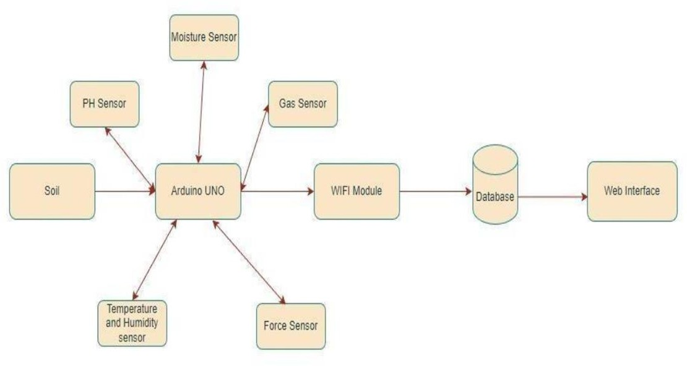
BLOCK DIAGRAM

Slide 9
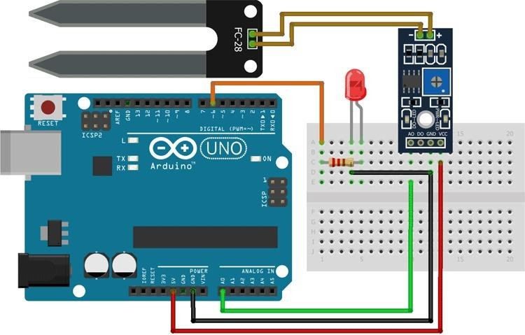
CIRCUIT DIAGRAM

Slide 10
NODE MCU
NodeMCU is a popular open-source IoT platform that uses the ESP8266 WiFi module. It allows developers to create connected devices with ease due to its built-in WiFi capability.
Hardware Components:
ESP8266 WiFi Module: The core of Node MCU, providing WiFi connectivity and a microcontroller. USB Interface: For power supply and programming.

Slide 11
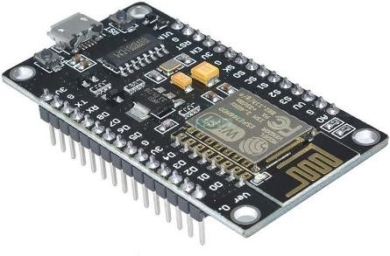
GPIO Pins: General Purpose Input/Output pins for interfacing with various sensors and actuators.
ADC: Analog-to-Digital Converter for reading analog sensors.
Power Supply: Typically 3.3V, supplied via USB or external sources.

Slide 12
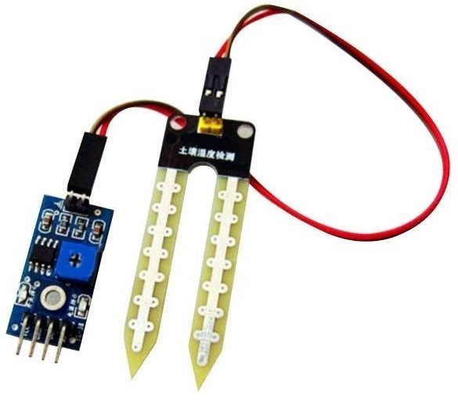
HUMIDITY ANALYZING SENSOR
The soil moisture sensor plays a critical role in an automatic irrigation system by providing essential data about the soil's moisture content. This data is used to determine when and how much water the system should supply to the plants.
When the soil moisture sensor detects that the soil moisture level falls below a pre-defined threshold, it indicates that the soil is dry.
Conversely, when the soil moisture sensor senses that the soil moisture level is above the pre-defined threshold, it indicates that the soil is wet.

Slide 13
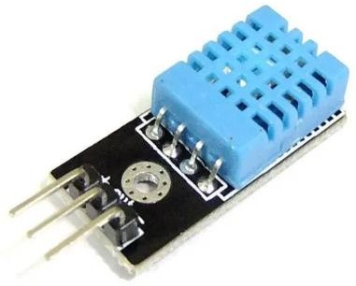
TEMPERATURE SENSOR
Accuracy: Determines how close the sensor's reading is to the actual temperature.
Range: The span of temperatures the sensor can accurately measure.
Response Time: How quickly the sensor responds to temperature changes.

Slide 14
WATERFLOW INDICATOR
The role of a water level indicator sensor in an automatic irrigation system is to monitor the water level in a reservoir or water source. It provides essential information to the microcontroller of the irrigation system, allowing it to make decisions .
The water level indicator sensor continuously monitors the water level in the reservoir or water source. It detects changes in water level and provides real-time data about the available water quantity.
The data collected by the water level indicator sensor serves as a crucial input for the automatic irrigation system's decision-making process. The sensor relays information about the current water level in the reservoir.

Slide 15
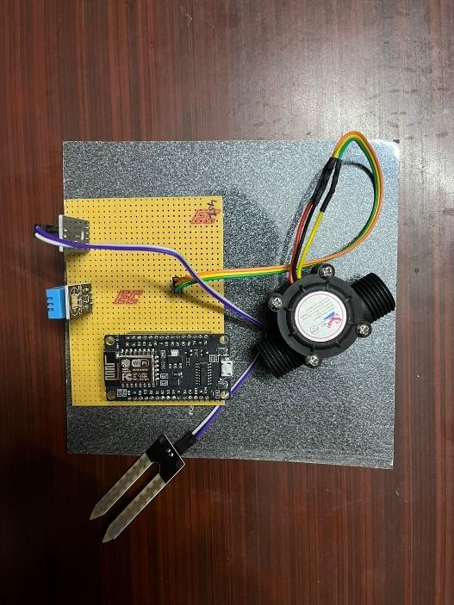
IMPLEMENTATION
The automatic irrigation system will continuously monitor the soil moisture and water level.
If the soil moisture falls below the defined threshold or the water level is critically low, the microcontroller will activate the water pump (or valve) to irrigate the plants.
The system will continue to operate as per the defined schedule and conditions, ensuring that the plants receive water when needed and conserving water resources when not required.

Slide 16
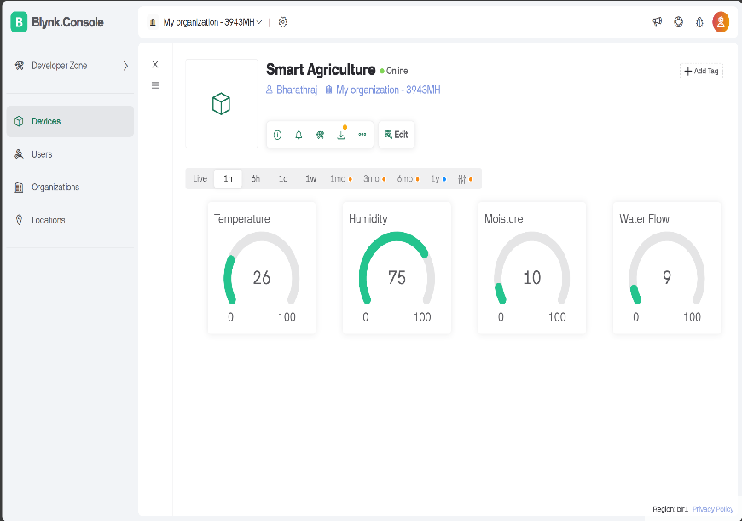
RESULT
Data points:
Temperature: 26%
Humidity: 75%
Moisture: 10%
Water Flow: 9%

Slide 17
CONCLUSION
Favorable conditions:
The temperature (26) seems to be within a good range for many plants.
Possible need for watering:
The moisture level (10%) is on the low side, suggesting the plants might need watering soon.
Water flow functioning:
The water flow (9) reading indicates the irrigation system is operational.

Slide 18
APPLICATION
Precision Farming:
Implement variable rate technology (VRT) to apply inputs (water, fertilizer, pesticides) precisely where needed.
Crop Selection and Rotation:
Choose appropriate crops and plan rotations based on soil conditions.
Soil Health Assessment:
Monitor changes in soil quality over time to detect degradation or improvement.
Pollution Detection:
Identify and manage soil contamination from heavy metals, pesticides, and other pollutants.

Slide 19
REFERENCES
[1] ”IOT Based Smart Agriculture And Soil Nutrient Detection System” by Akshay Badhe, Sandeep Kharadkar, Rushikesh Ware, Pratik Kamble on International Journal on Future Revolution in Computer Science Communication Engineering ISSN: 2454- 4248,Volume: 4 Issue: 4.
[2] “Remote environmental monitoring using Internet of Things (IoT)” by S. Abraham ,JBeard and R. Manijacob,2017 IEEE Global Humanitarian Technology Conference (GHTC), San Jose, CA, USA, 2017, pp. 1-6, doi: 10.1109/GHTC.2017.8239335.

Slide 20
[3]”IoT based Soil Nutrient Testing System” by Sanket Kasturiwala, Sakshi Sarage, AditiDoye, Dashmeet Khurana, Sachin Yadav ,International Journal of Science and Research (IJSR) ISSN: 2319-7064 ,Impact Factor (2018): 7.426
[4]”IoT based smart soil monitoring system for agricultural production” by N. Ananthi, J.Divya, M. Divya and V. Janani,2017 IEEE Technological Innovations in ICT for Agriculture and Rural Development (TIAR), Chennai, India, 2017, pp. 209-214, doi: 10.1109/TIAR.2017.8273717.

Slide 21
[5] ”The IoT-Based Monitoring Systems for Humidity and Soil Acidity Using Wireless Communication” by L. Kamelia, Y. S. Nugraha, M. R. Effendi and T. Priatna,2019 IEEE 5th International Conference on Wireless and Telematics (ICWT), Yogyakarta, Indonesia, 2019, pp. 1-4, doi: 10.1109/ICWT47785.2019.8978243.
[6] ”The IoT-Based Monitoring Systems for Humidity and Soil Acidity Using Wireless Communication” by L. Kamelia, Y. S. Nugraha, M. R. Effendi and T. Priatna,2019 IEEE 5th International Conference on Wireless and Telematics (ICWT), Yogyakarta, Indonesia, 2019, pp. 1-4, doi: 10.1109/ICWT47785.2019.8978243.

Slide 22
THANK YOU

